Slide 1
Cornerstone City Church Peninsula Plus Community Hoo Are Ya
20th October 2024

Slide 2


Slide 3
I reach Up High
CCLI Song # 1075387
Judy Bailey
© 1993 Song Solutions Daybreak (Admin. by Song Solutions www.songsolutions.org)
For use solely with the SongSelect® Terms of Use. All rights reserved. www.ccli.com
CCLI Licence No. 33265

Slide 4
1/3
I reach up high I touch the ground
I stomp my feet and turn around
I've got to (woo woo) Praise the Lord
I jump and dance with all my might
I might look funny but that's alright
I've got to (woo woo)
Praise my Lord

Slide 5
2/3
I'll do anything just for my God
'Cause He's done ev'rything for me
It doesn't matter who is looking on
Jesus is the person that I want to please

Slide 6
3/3
May my whole life be a song of praise
To worship God in ev'ry way
In this song the actions praise His name
I want my actions ev'ry day to do the same

Slide 7
Your Mercy Flows
Dele Olajide

Slide 8
1/7
Your mercy flows
Like a river through my soul
Your love came down and
Picked me off the ground
As your grace abounds,
I lift my voice in praise

Slide 9
2/7
Praise the Lord with me
Lift your voice and sing
'Cos there is no one like Him
Jesus our King

Slide 10
3/7
Praise the Lord with me
Move your feet and dance
Cos there is a second chance
With Jesus our King

Slide 11
4/7
Your Spirit calls my heart to receive
Forgiveness free, even for me
As your grace abounds, my fears all fade away

Slide 12
5/7
Praise the Lord with me
Lift your voice and sing
'Cos there is no one like Him
Jesus our King

Slide 13
6/7
Praise the Lord with me
Move your feet and dance
Cos there is a second chance
With Jesus our King

Slide 14
7/7
Lift your voice, move your feet,
Let the praise begin
Sing a song, move your body
Let those praises ring
'Cos there is no one like Him
Jesus our King

Slide 16
I Speak Jesus
CCLI Song # 7136201
Abby Benton | Carlene Prince | Dustin Smith | Jesse Reeves | Kristen Dutton | Raina Pratt
© 2019 Here Be Lions Publishing (Admin. by Integrity Music Ltd)
Integrity's Praise! Music (Admin. by Integrity Music Ltd)
BEC Worship (Admin. by Song Solutions)
Raina Pratt publishing designee (Admin. by Song Solutions www.songsolutions.org)
WriterWrong Music (Admin. by Song Solutions www.songsolutions.org)
Remaining portion is unaffiliated
For use solely with the SongSelect® Terms of Use. All rights reserved. www.ccli.com
CCLI Licence No. 33265

Slide 17
1/5
I just want to speak the Name of Jesus
Over ev'ry heart and ev'ry mind
'Cause I know there is peace within Your presence
I speak Jesus

Slide 18
2/5
I just want to speak the Name of Jesus
'Til ev'ry dark addiction starts to break
Declaring there is hope and there is freedom
I speak Jesus

Slide 19
3/5
('Cause) Your Name is power
Your Name is healing
Your Name is life
Break ev'ry stronghold
Shine through the shadows
Burn like a fire

Slide 20
4/5
I just want to speak the Name of Jesus
Over fear and all anxiety
To ev'ry soul held captive by depression
I speak Jesus

Slide 21
5/5
Shout Jesus from the mountains
Jesus in the streets
Jesus in the darkness over ev'ry enemy
Jesus for my fam'ly
I speak the holy Name Jesus

Slide 23
Revelation Song
CCLI Song # 4447960
Jennie Lee Riddle
© 2004 Gateway Create Publishing (Admin. by Integrity Music Ltd)
For use solely with the SongSelect® Terms of Use. All rights reserved. www.ccli.com
CCLI Licence No. 33265

Slide 24
1/4
Worthy is the Lamb Who was slain
Holy holy is He
Sing a new song to Him Who sits on
Heaven's mercy seat

Slide 25
2/4
Holy, Holy, Holy
Is the Lord God Almighty
Who was and is and is to come
With all creation I sing
Praise to the King of kings
You are my ev'rything
And I will adore You

Slide 26
3/4
Clothed in rainbows of living colour
Flashes of lightning rolls of thunder
Blessing and honour strength and Glory and power be
To You the only wise King

Slide 27
4/4
Filled with wonder awestruck wonder
At the mention of Your name
Jesus Your name is power breath and living water
Such a marv'lous mystery

Slide 28


Slide 29


Slide 30
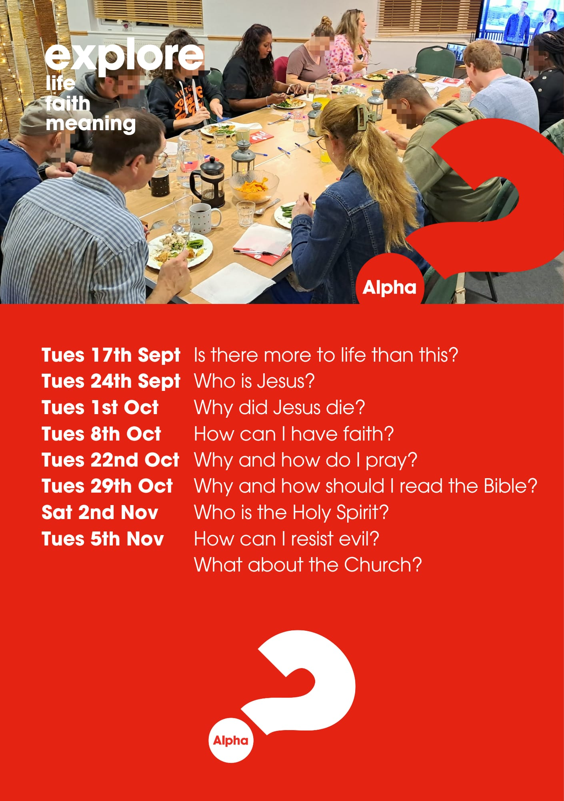

Slide 31
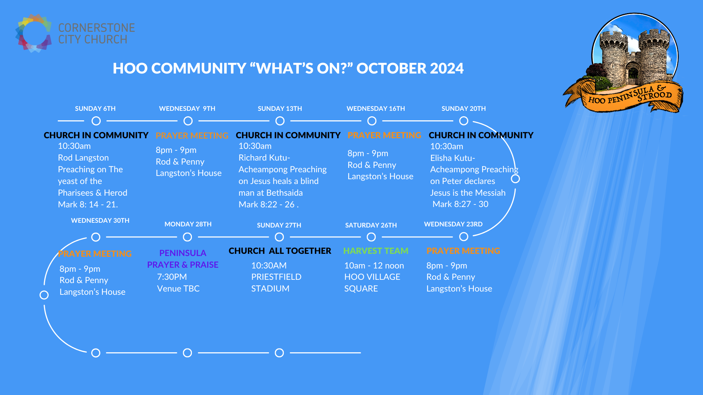

Slide 32
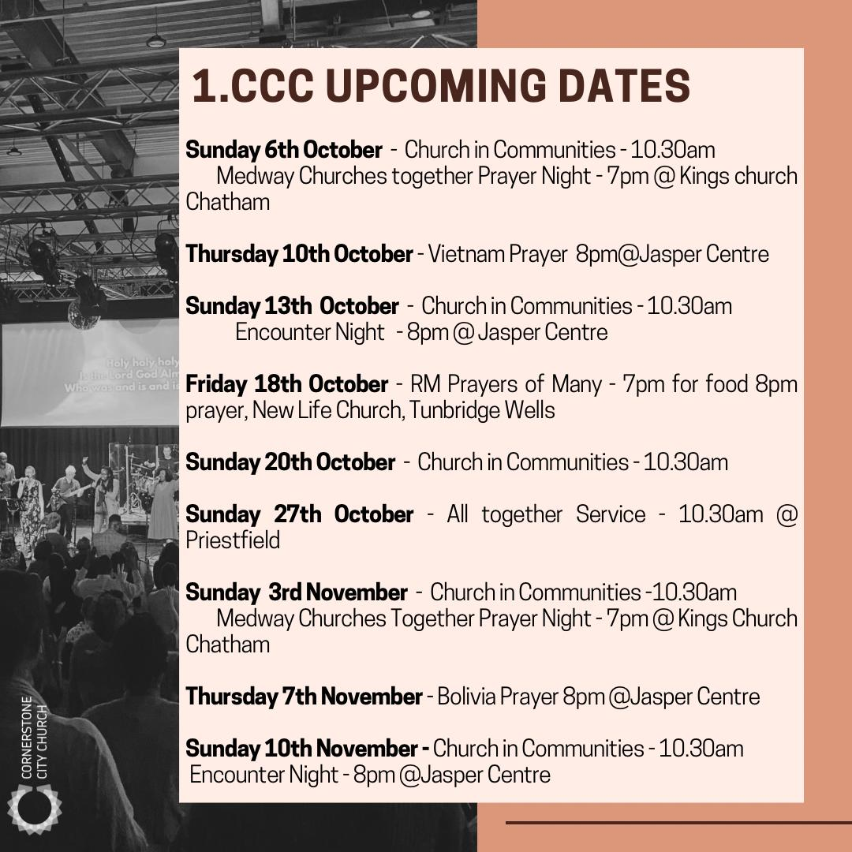

Slide 33
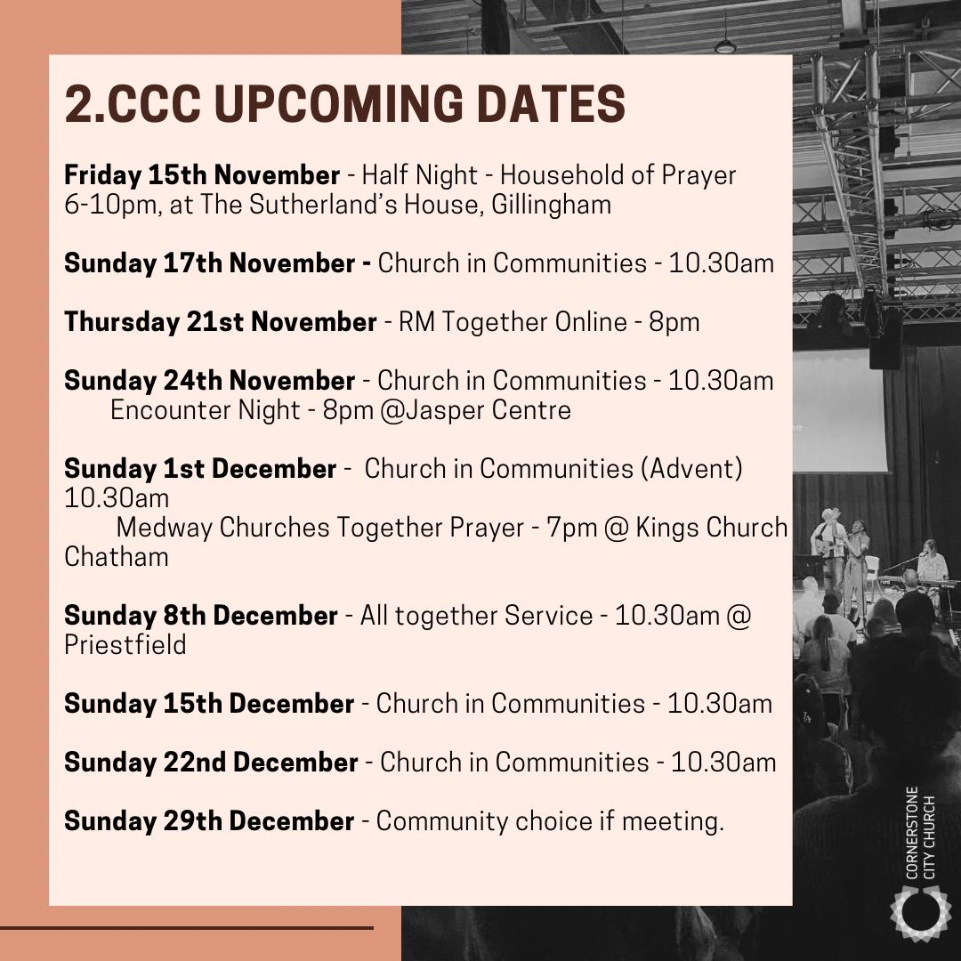

Slide 34


Slide 35
2 Corinthians 14 May the grace of the Lord Jesus Christ, and the love of God, and the fellowship of the Holy Spirit be with you all

